Slide 1
Event Finder App
By Lam Ngo

Slide 2
Motivation
On some weekends or breaks where I find myself extremely bored without nothing to do, I want to go and do something
Unfortunately I don’t really know the area all so well so I just don’t know what kind of events/activity is going on around me
This would cure people of boredom

Slide 3
Proposal
Create a app that would be able to create a list of events or activities within a user set area and time/date.

Slide 4
Features
Allow users to set a area that they would be willing to travel to
Allow users to see what event/activity that is coming up around certain areas
Users can set what kind of events/activity that they would want to attend to
Would have a “surprise me” feature that would recommend popular events/activities to the user based on physical activity level and age of user.

Slide 5
Requirements
Android 4.0
Some kind of connection to the internet

Slide 6
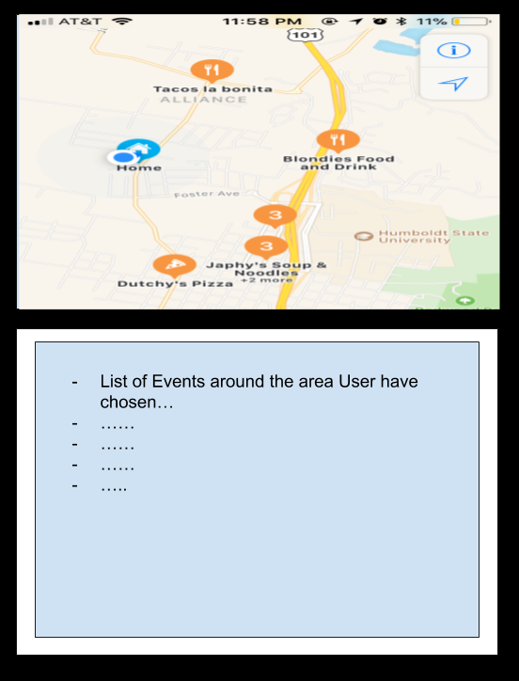
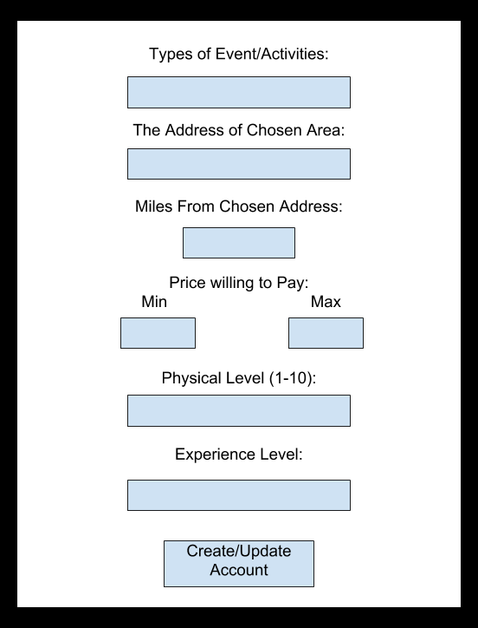
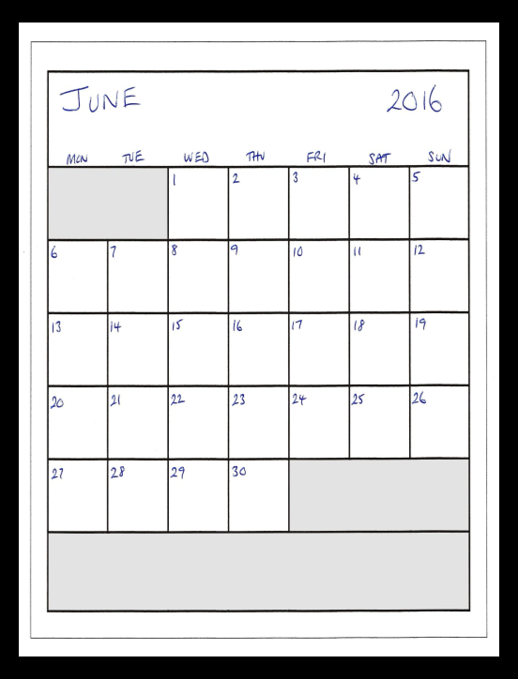
Mockups
Main Screen/Event or Activity Account Creation/Update Screen Event Planner Screen

Slide 7
Timeline
Week 1: Get some kind of database up and working
Week 2-3: Work on all functionally on all screens
Week 4: Work on the program where the app would use to figure out what events the user would want to attend to.
Week 5-6, maybe more: Create some kind of program or crawler that would go through websites looking for events that are taking place around the selected area within the selected date and time.

